Slide 1
Civics and Citizenship
Rights and Responsibilities

Slide 2

DO NOW
What is a right?
What is a responsibility?
Define and provide an example of each.

Slide 3
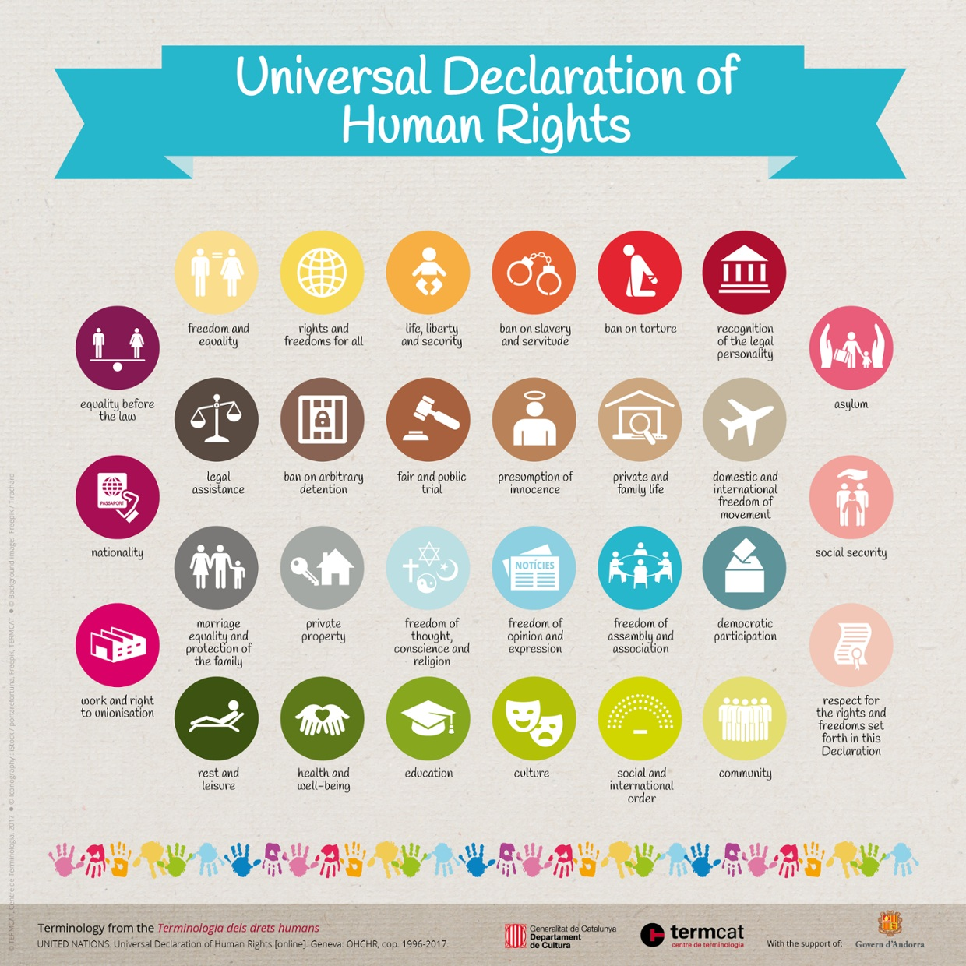
Human Rights
In 1948, the United Nations created a Universal Declaration of Human Rights.
Some of these rights include:
  Free Speech
  Free education
  Access to water

Slide 4
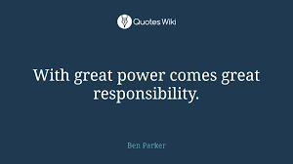
With our rights, comes great responsibility
Every right implies a responsibility not to use that right in a way which interferes with another person’s rights.
For example, the right to freedom of movement would not give you the right to drive the wrong way along a one-way street. Exercising that ‘right’ would be dangerous for other people and create social chaos.
Discuss these with the person next to you:
We would all want the right to a free education. But where does that end? At primary level? At secondary level? At tertiary level? Never?
We all want the right to free speech. But where does that right end? Does it give us the right to discriminate against someone, or to tell lies about other people?

Slide 5
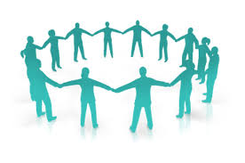
Examples:
If we have a right to life, then we have the obligation to respect life.
If we have a right to liberty, then we have the obligation to respect other people’s liberty.
If we have a right to security, then we have the obligation to create the conditions for every human being to enjoy human security.

Slide 6
Your turn! Complete the following sentences in your book.
If we have a right to take part in political processes, then we have a responsibility to ...
If we have a right to work in just conditions, then we have a responsibility to ...
If we have a right to freedom of thought, conscience and religion, then we have a responsibility to ...
If we have a right to be educated, then we have a responsibility to ...
If we have a right to benefit from the Earth's resources, then we have a responsibility to ...

Slide 7
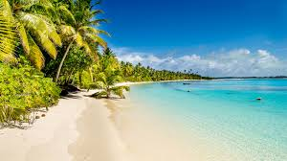
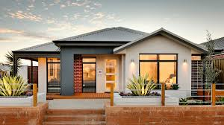
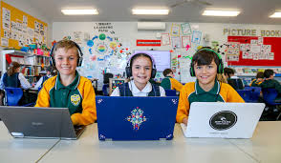
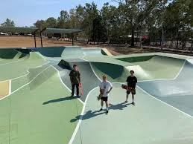

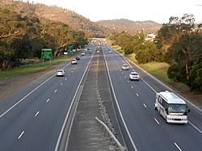
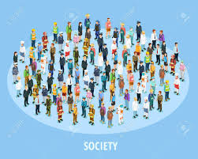
Group Activity:
In groups of 3-4, design a declaration of rights and responsibilities for your chosen context to present to your peers.
For example: Home, School, Skate Park, Society, Australian Roads, Beach etc.
OR you can create one for COVID-19

